Slide 1
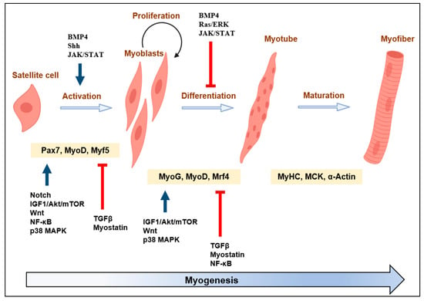
Notes:
From:

Slide 2
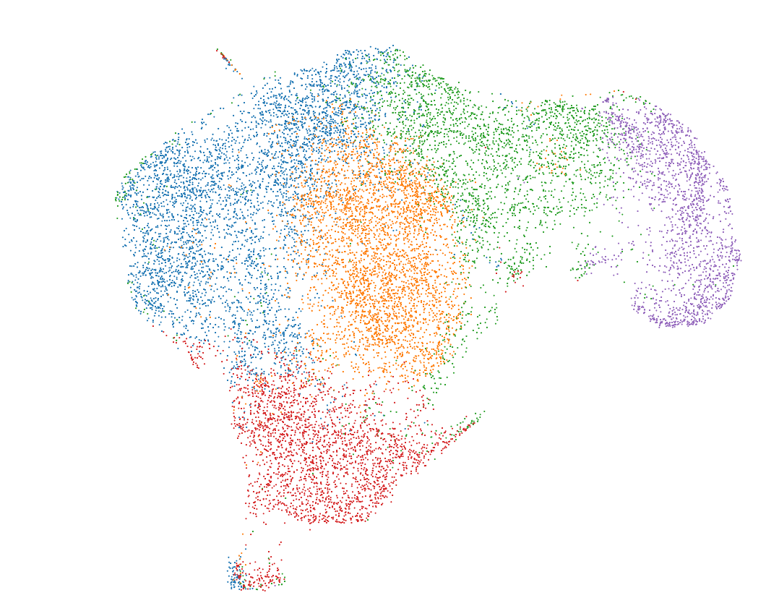
Day 8
RNA UMAP + K-means clustering (k=5)
Notes:
From the 10X pipeline

Slide 3
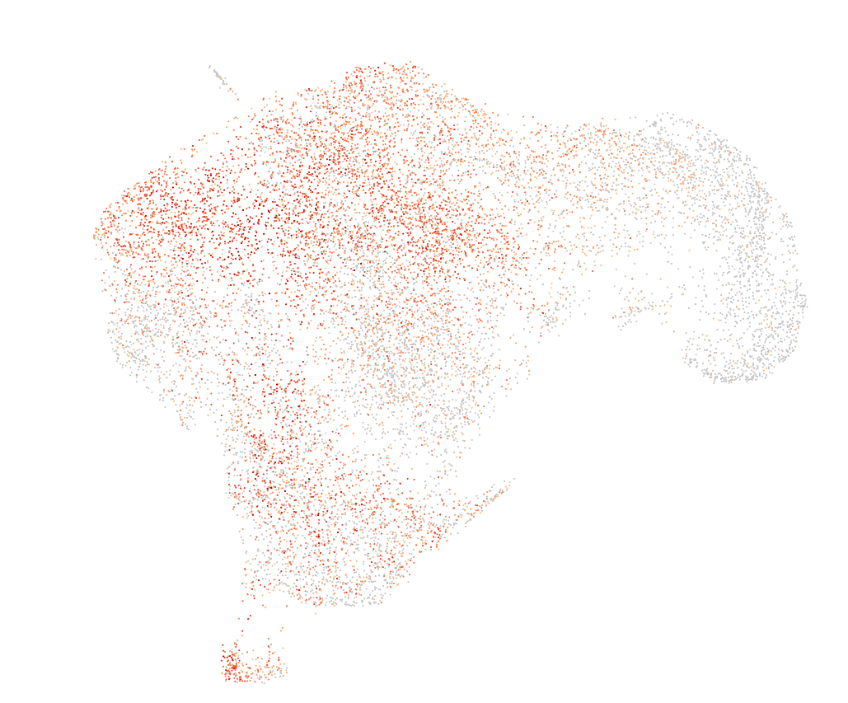
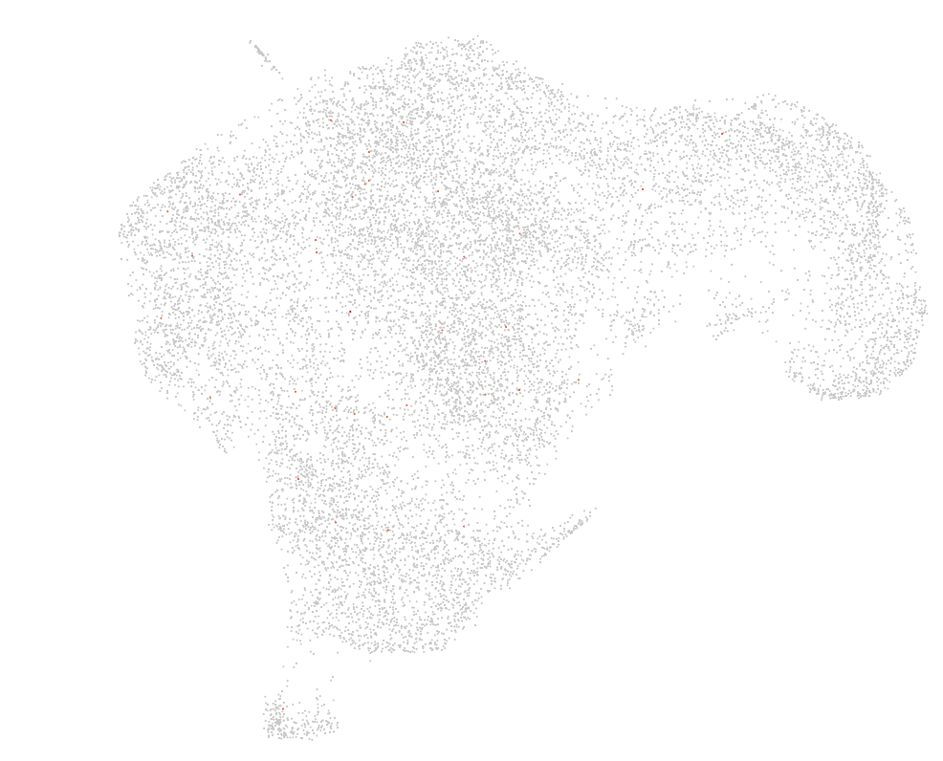
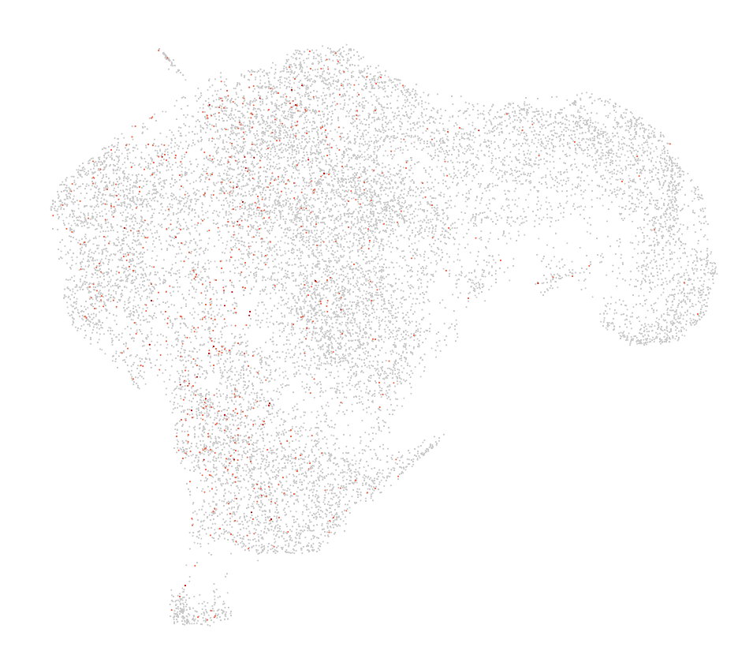
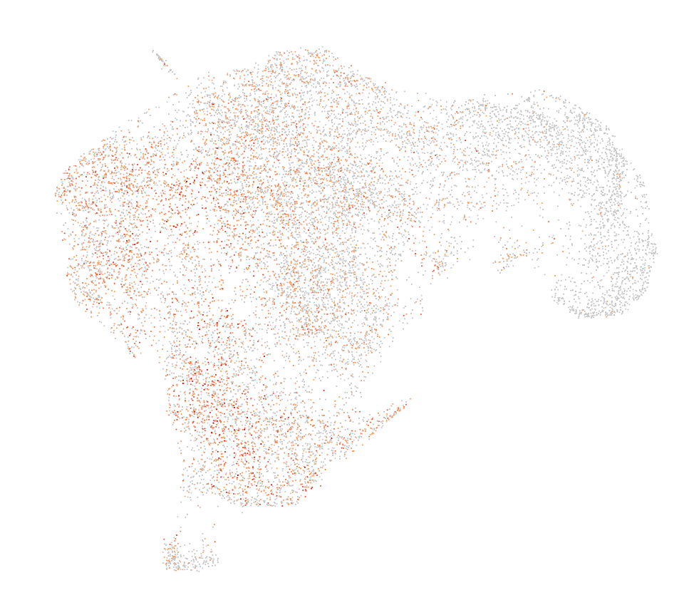
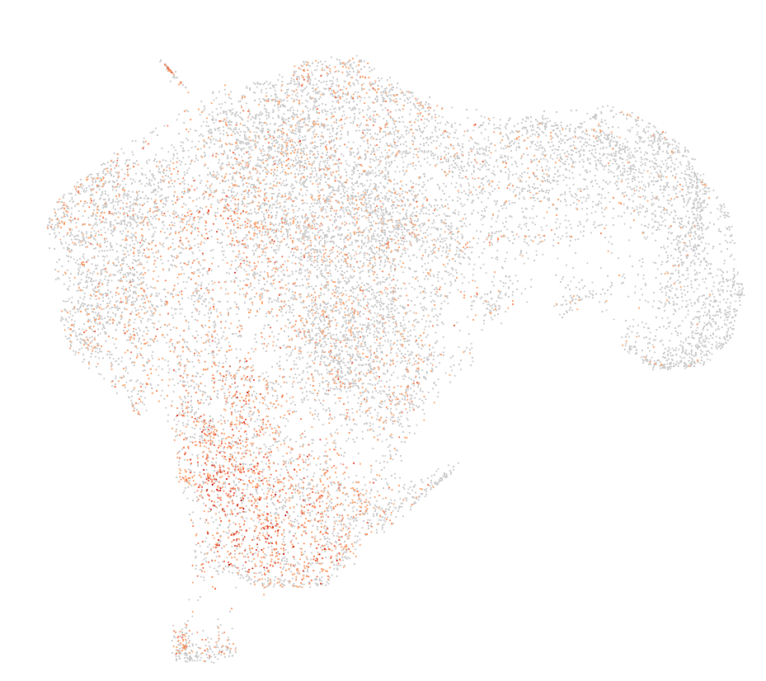
Day8: Initial analysis mucles cells markers
Cluster assignments
PAX3
PAX7
MYOD1
MYOG
OGN
PDGFRA
HEY1
Notes:
No expression of muscle cell markers (PAX7, MYOD1,…), but a bit of the OGN PDGFRA -> messenchymal

Slide 4
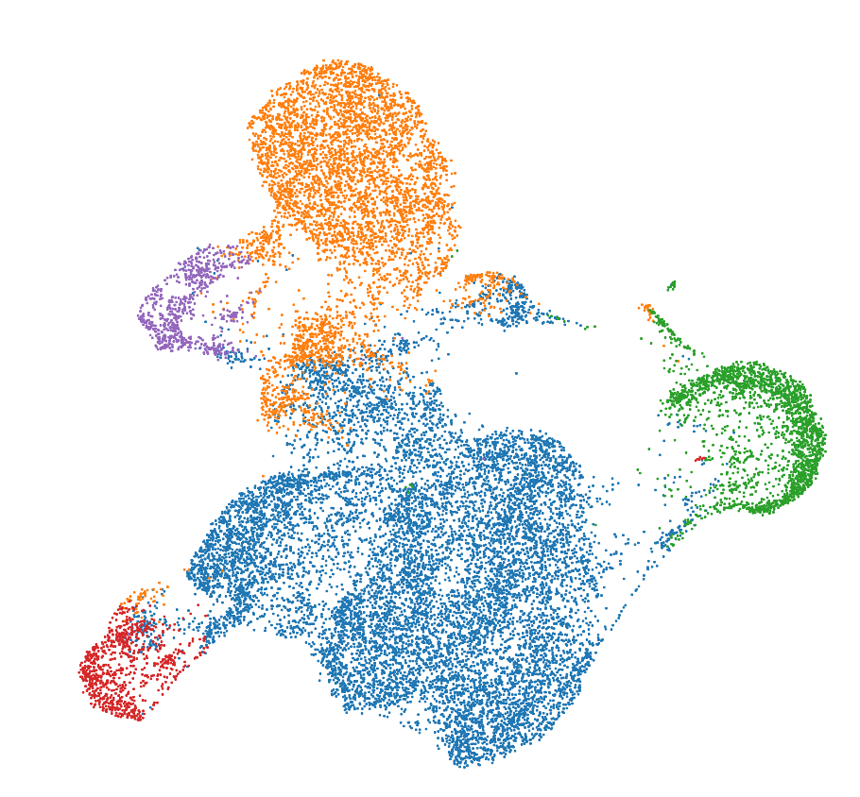
Day 12
RNA UMAP + K-means clustering (k=5)
Notes:
From the 10X pipeline

Slide 5
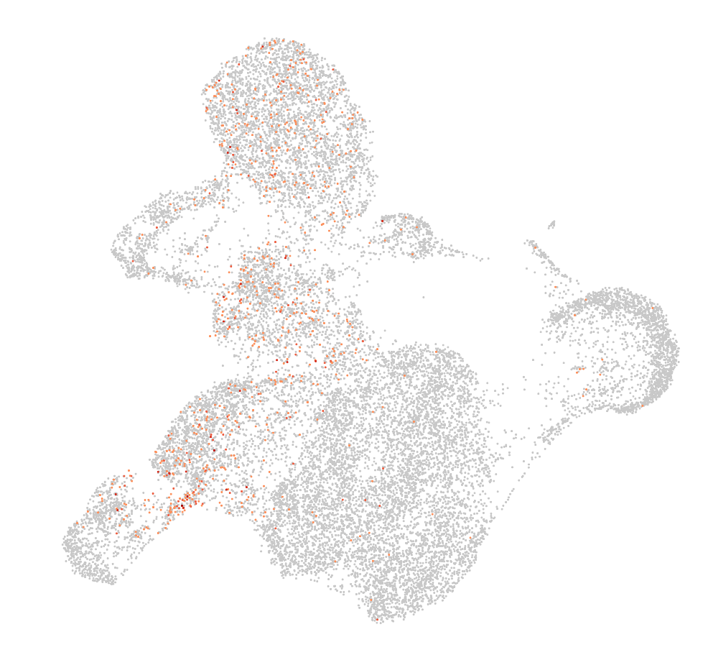
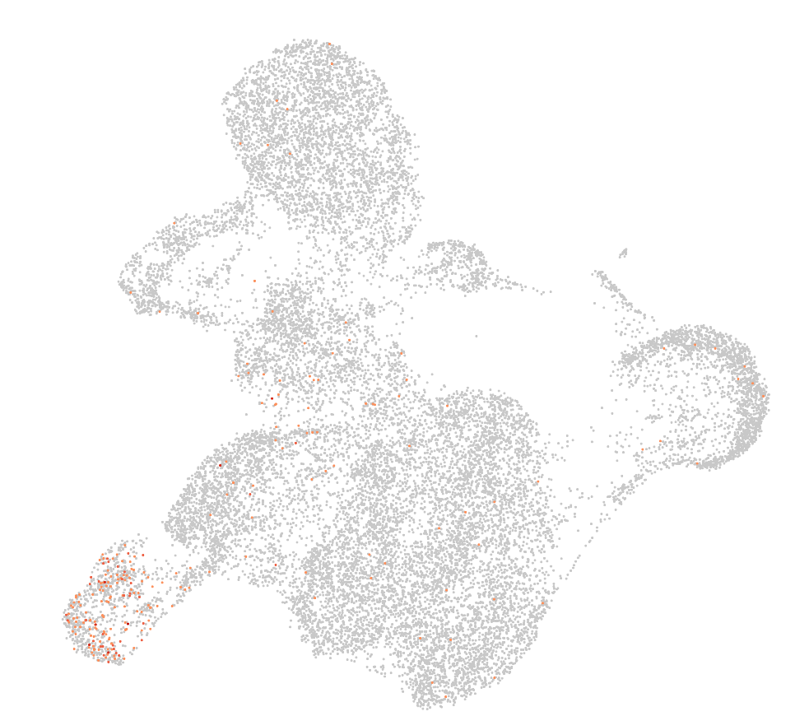
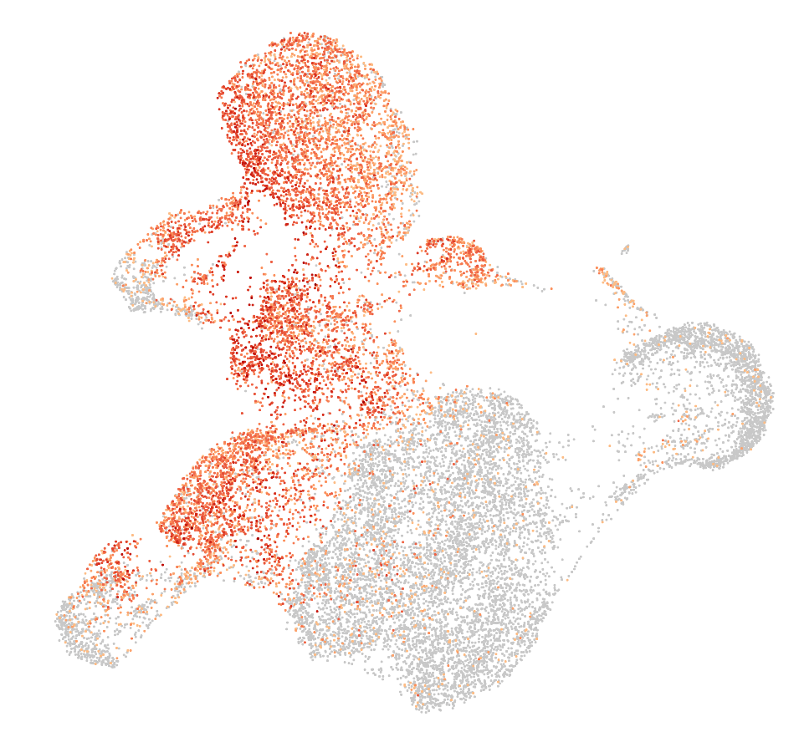
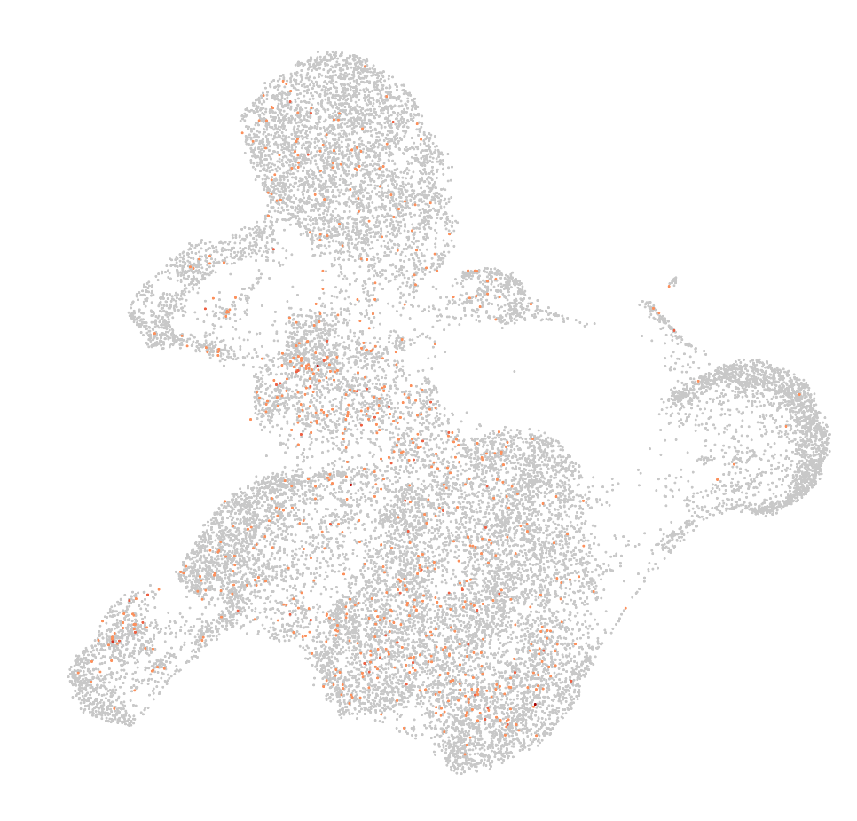
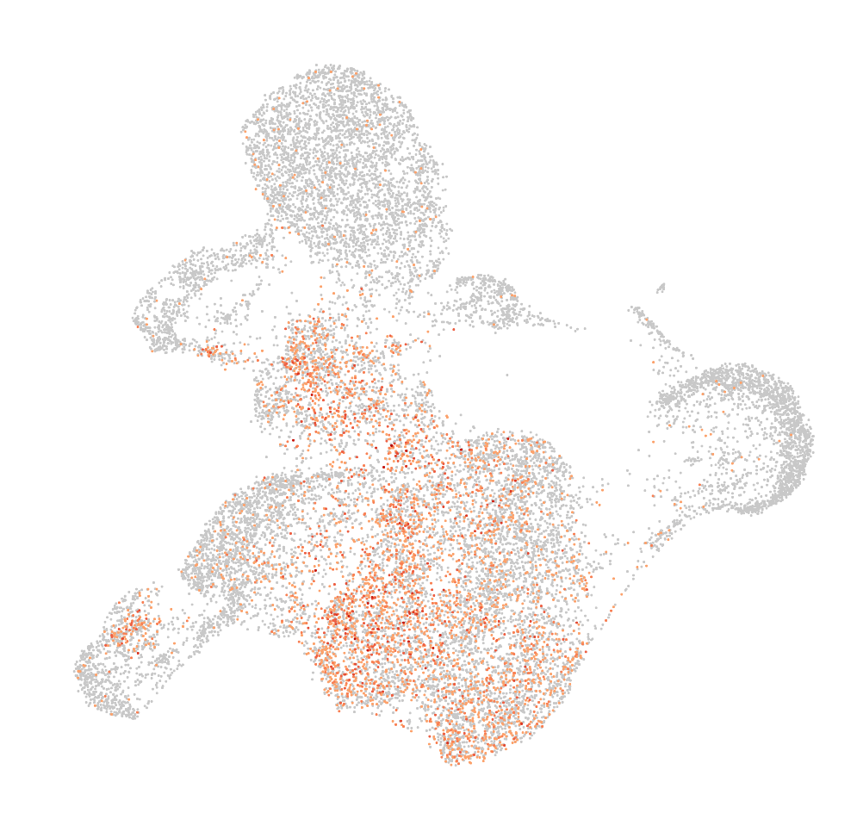
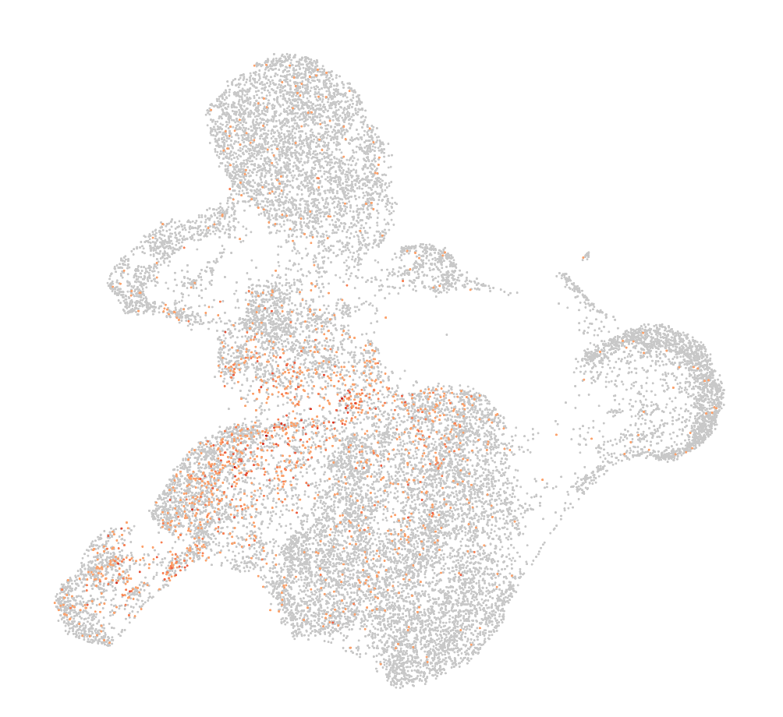
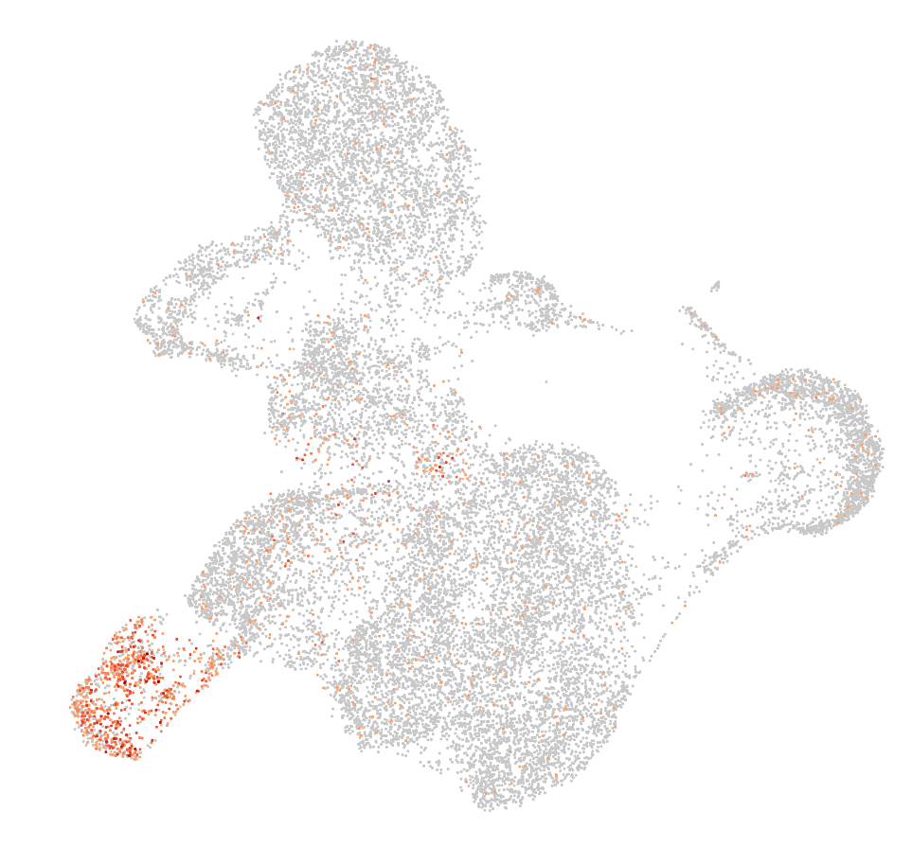
Day12: Initial analysis mucles cells markers
Cluster assignments
PAX3
PAX7
MYOD1
MYOG
OGN
PDGFRA
HEY1
Notes:
No expression of muscle cell markers (PAX7, MYOD1,…), but a bit of the OGN PDGFRA -> messenchymal

Slide 6
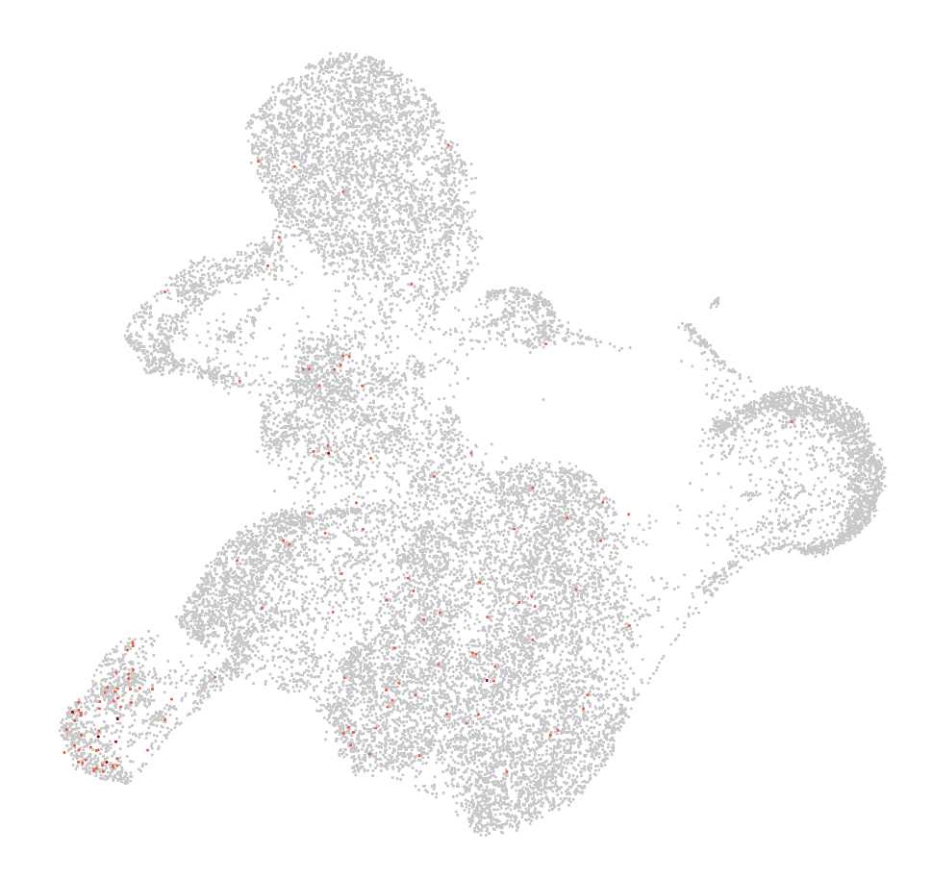
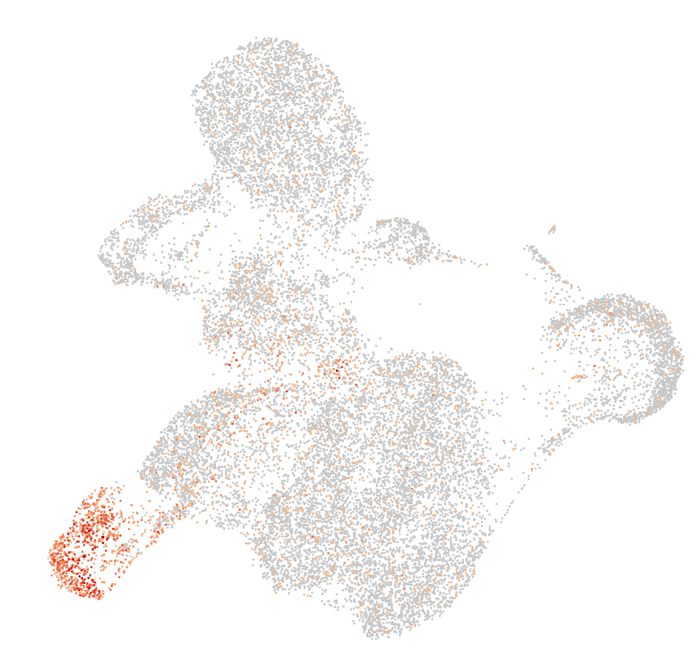
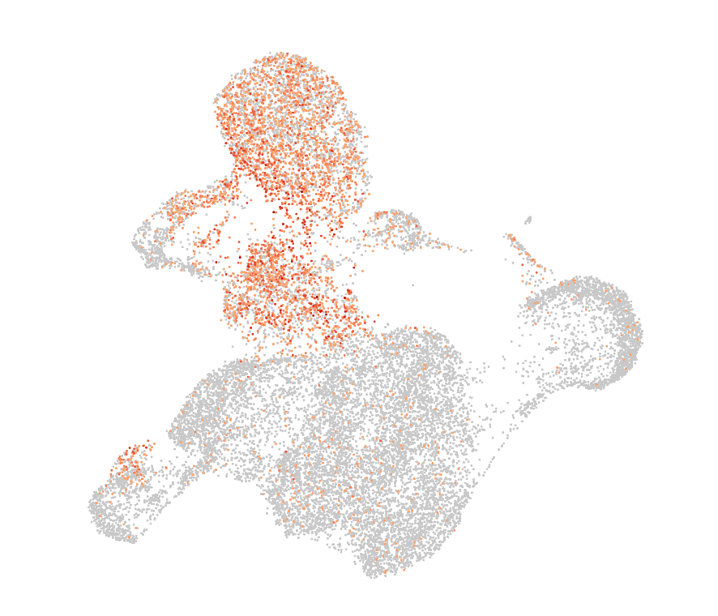
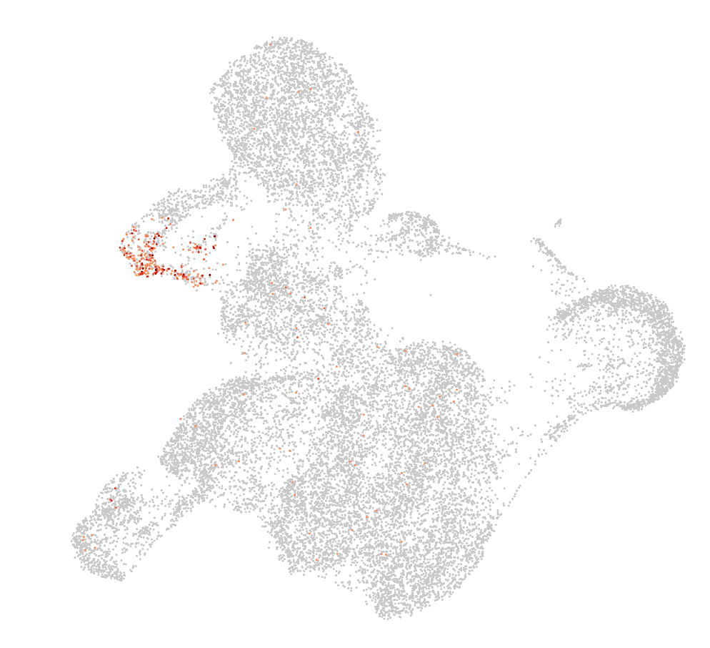
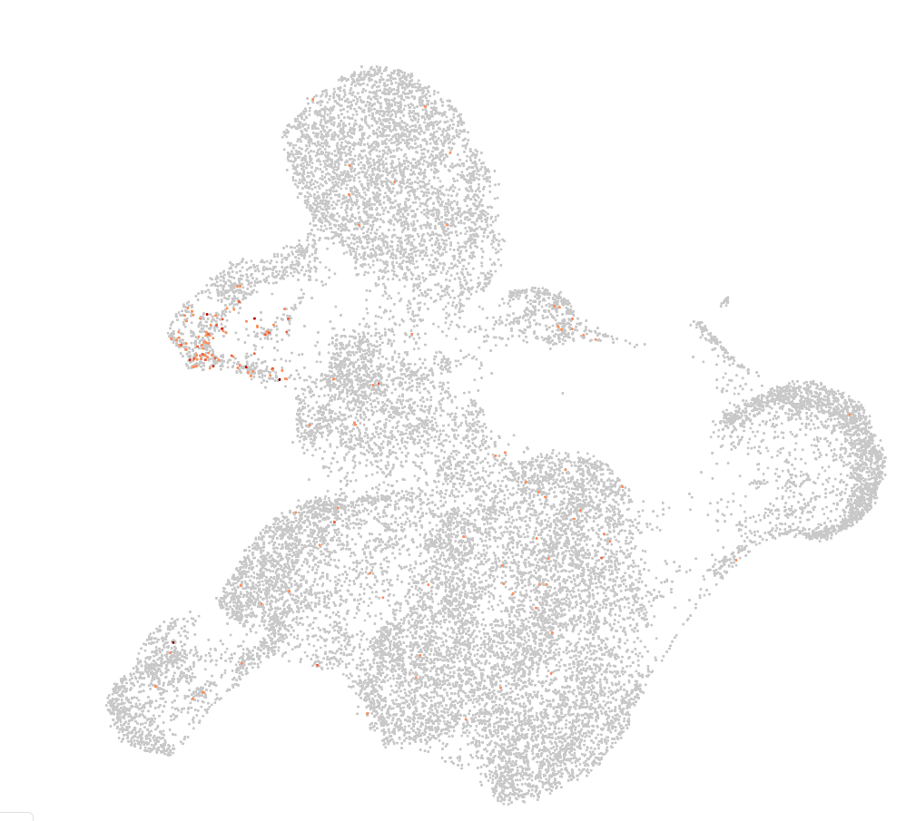
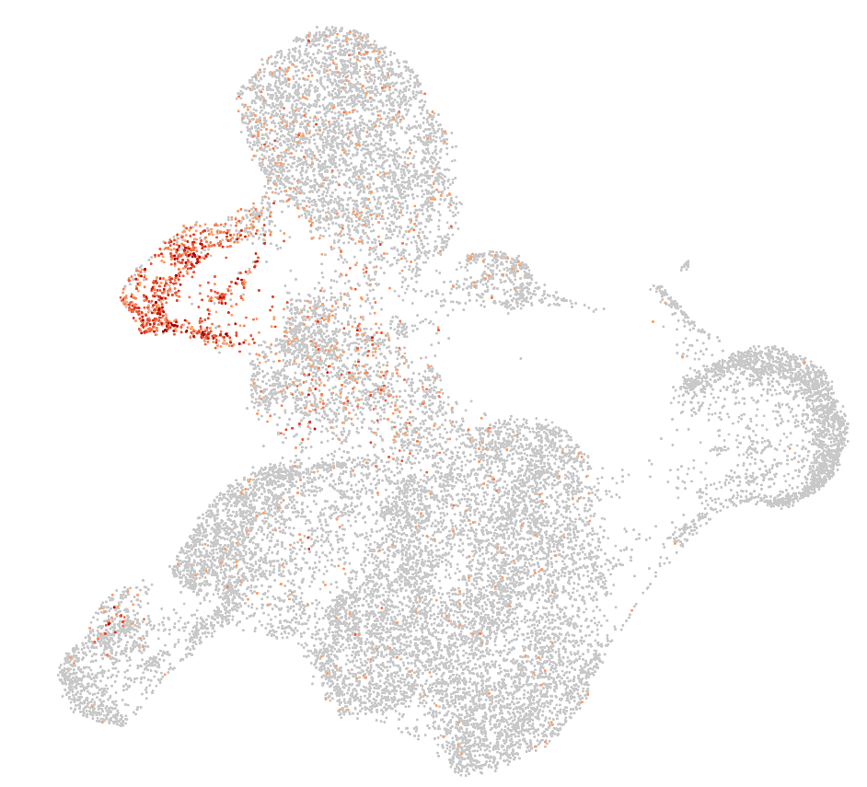
Day12: Initial analysis mucles cells markers
Cluster assignments
CKM
SOX2
TNNT1
MYT1L
GRIA2
SRRM4
-> associated with neuronal tissues
Notes:
First row more muscle cell markers
Second row top 3 differently expressed gene in green cluster -> associated with neuronal tissues

Slide 7
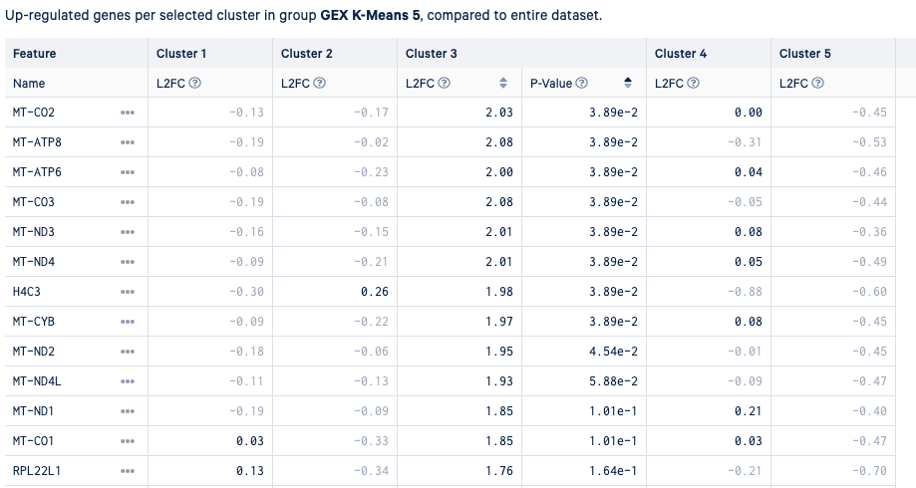
Mitochondrial cell almost all differently expressed genes ->
dead cells?

Slide 8
Day12
Myogenetic progenitors
Neuronal tissues
Dead cells
Myoblast
Skeletal Mesenchymal
Myocytes + myotube
Notes:
Blue probably at leat two clusters ->

Slide 9
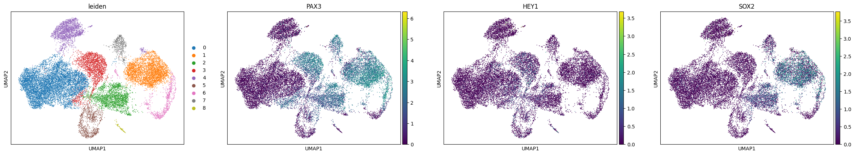
Day12: scanpy clustering
Not really conviced by quality of clustering -> Did not do any filtering of cells + high mitochondrial genes counts
=> Probly not great idea to interpret what we see here and derive clusters

Slide 10
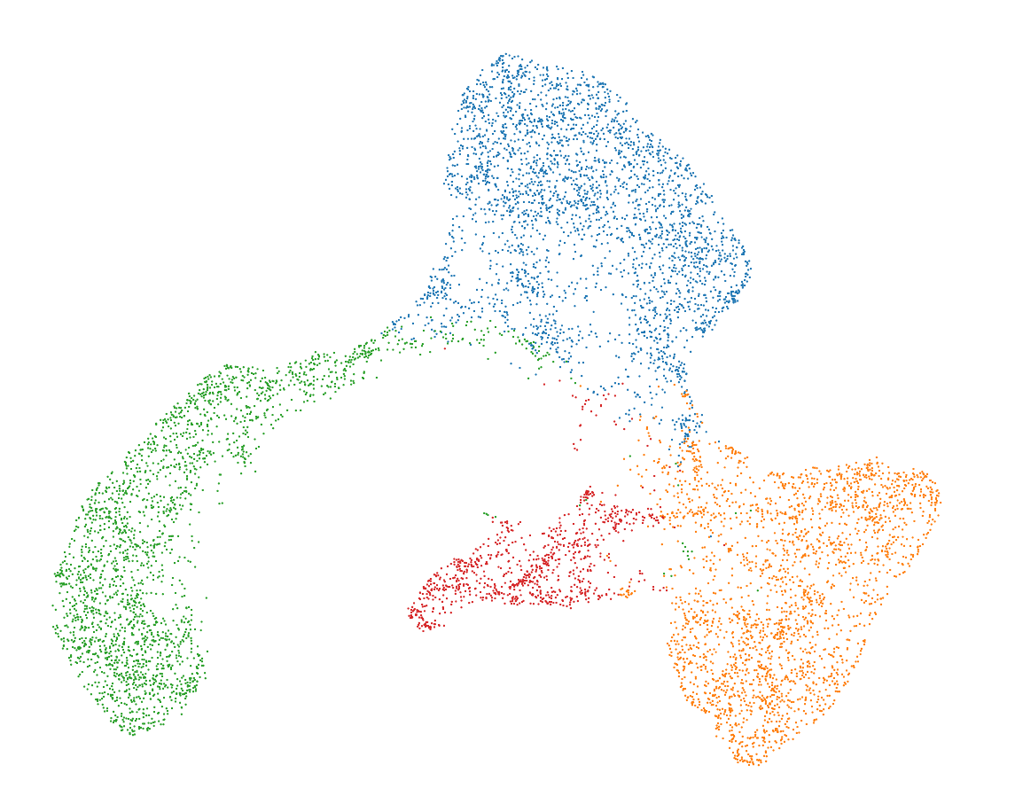
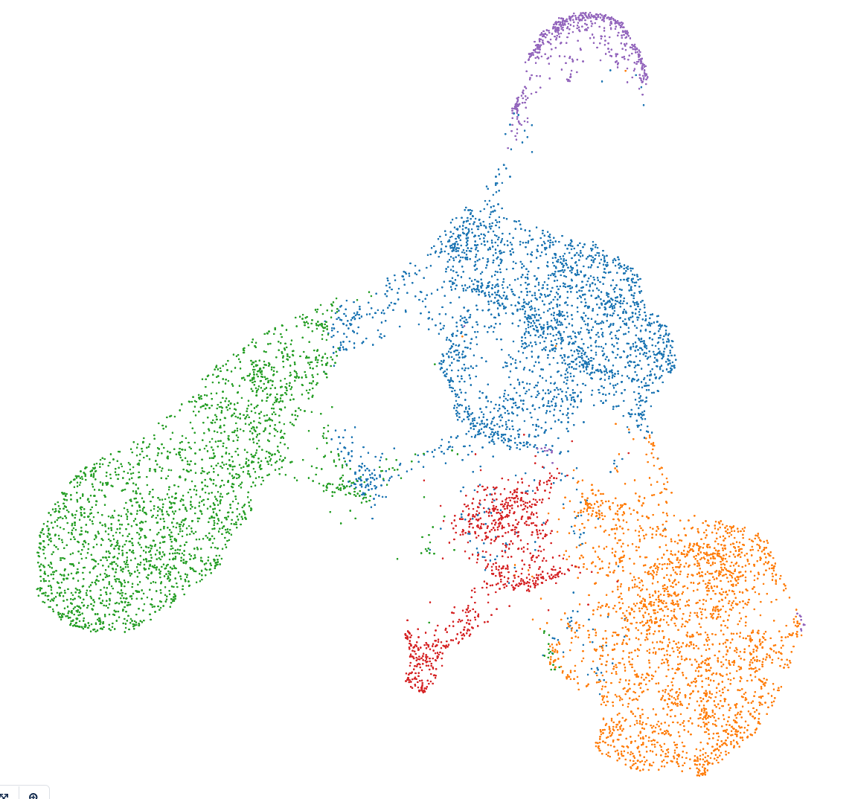
Day 22
ATAC UMAP + K-means clustering (k=4)
RNA UMAP + K-means clustering (k=5)
Notes:
From the 10X pipeline

Slide 11
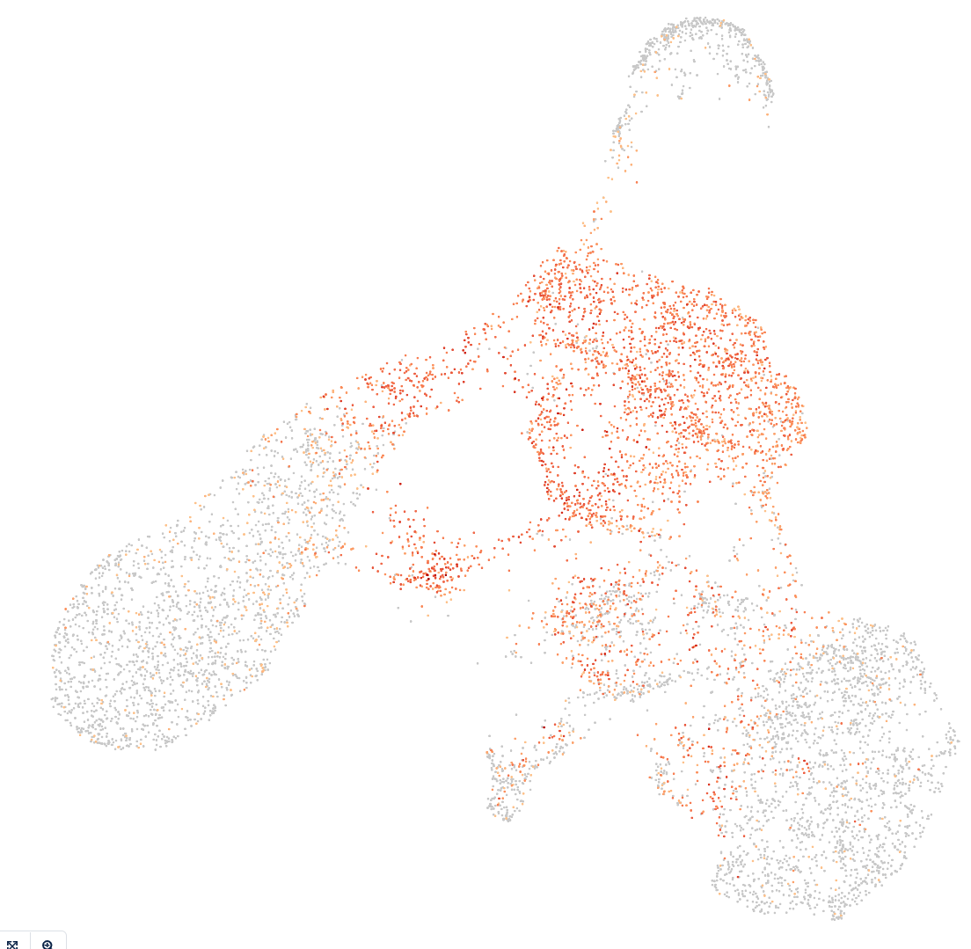
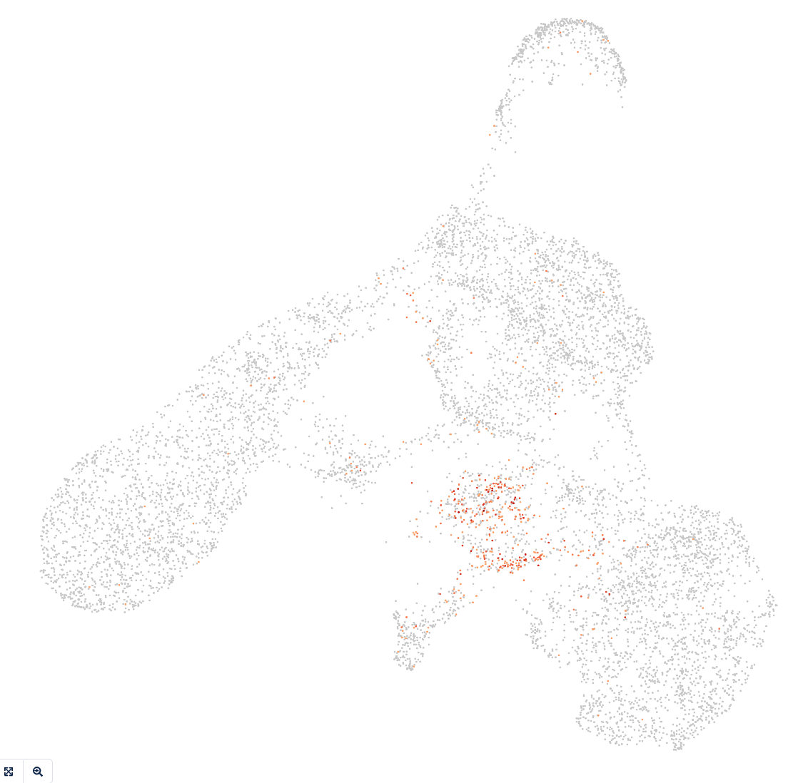
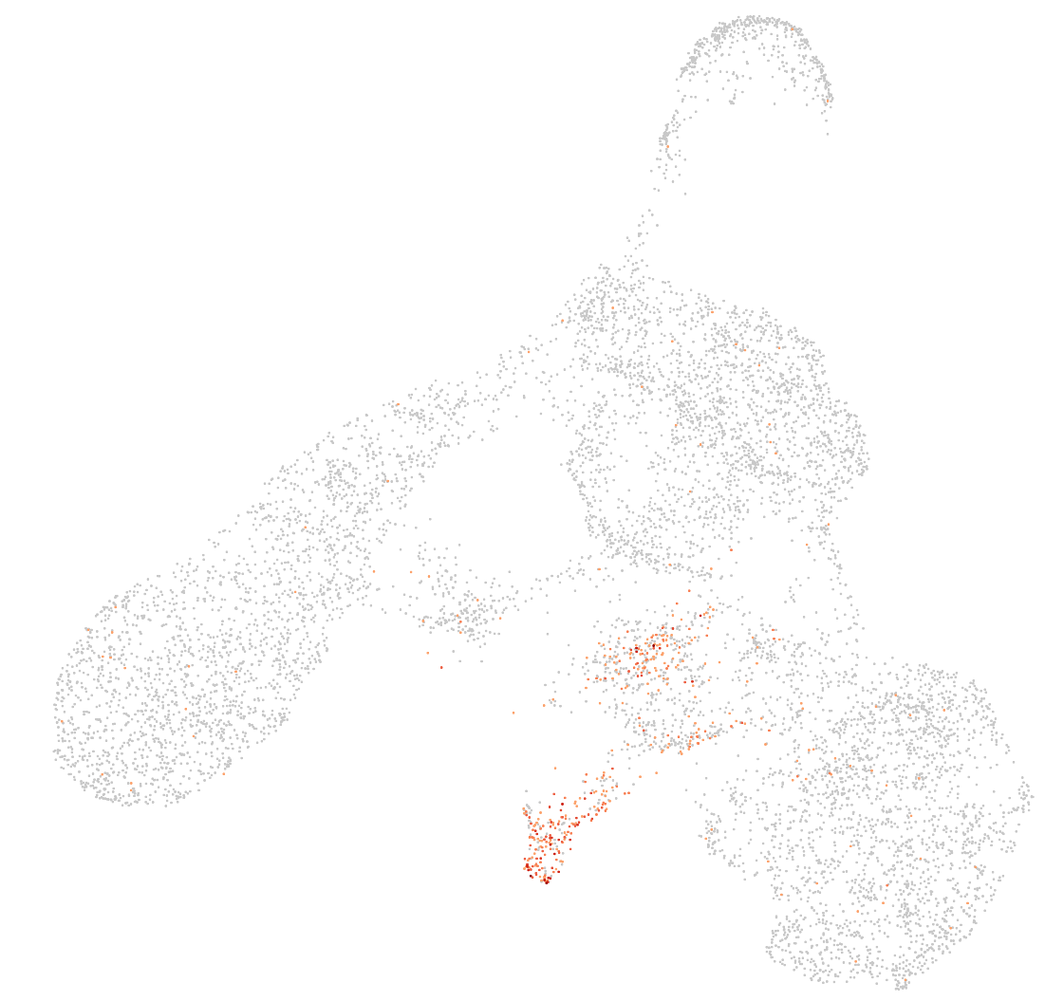
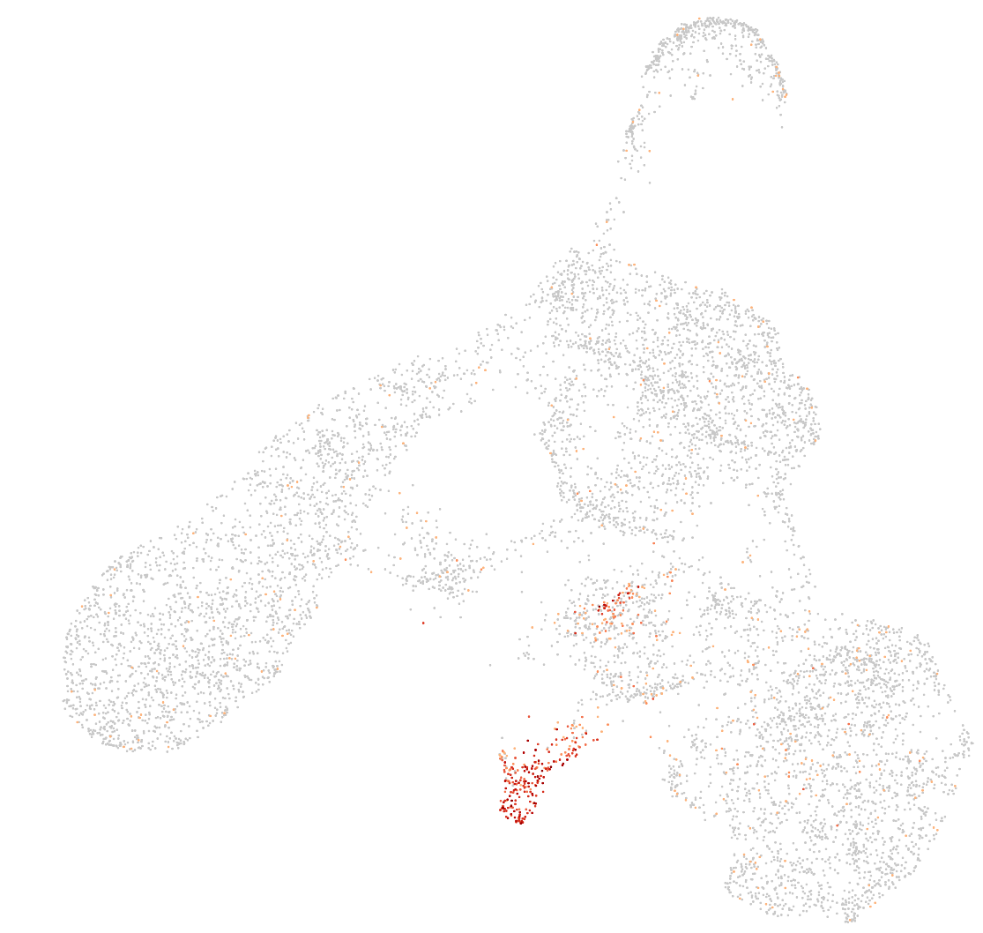
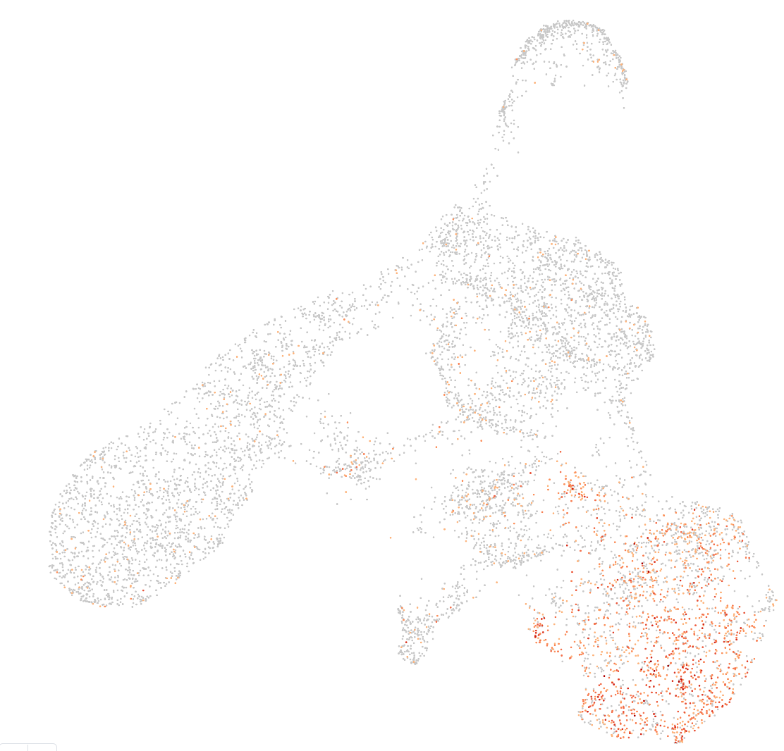
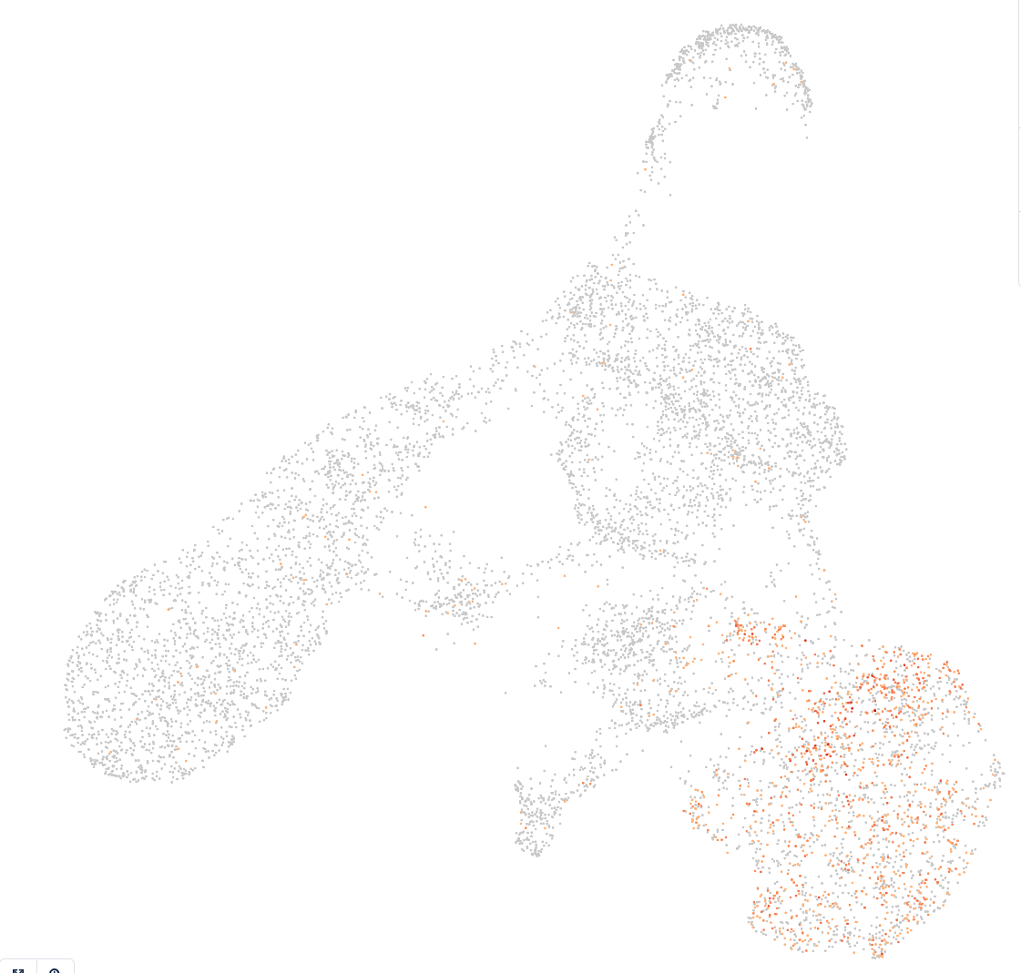
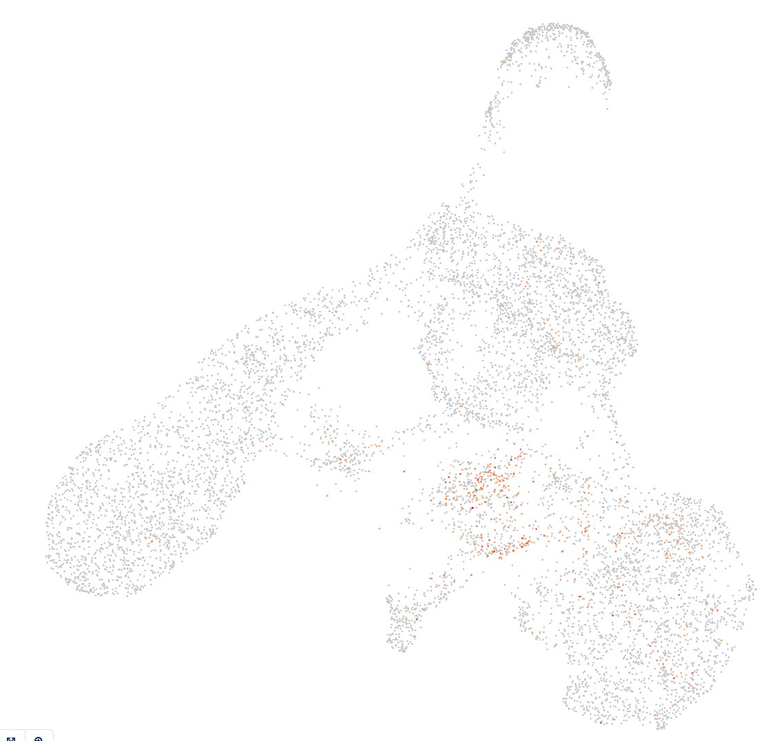
Day22: Initial analysis mucles cells markers
Cluster assignments
PAX3
PAX7
MYOD1
MYOG
OGN
PDGFRA
HEY1
Notes:
Possible cell types: myogenetic progenitors, myoblasts, myocytes, Skeletal mesenchymal, myotube, myofiber
Gene markers described in
Haibin Xi, Justin Langerman, Shan Sabri, Peggie Chien, Courtney S. Young, Shahab Younesi, Michael Hicks, Karen Gonzalez, Wakana Fujiwara, Julia Marzi, Simone Liebscher, Melissa Spencer, Ben Van Handel, Denis Evseenko, Katja Schenke-Layland, Kathrin Plath, April D. Pyle,
A Human Skeletal Muscle Atlas Identifies the Trajectories of Stem and Progenitor Cells across Development and from Human Pluripotent Stem Cells,
Cell Stem Cell,
Volume 27, Issue 1,
2020,
Pages 158-176.e10,
ISSN 1934-5909,
https://doi.org/10.1016/j.stem.2020.04.017.

Slide 12
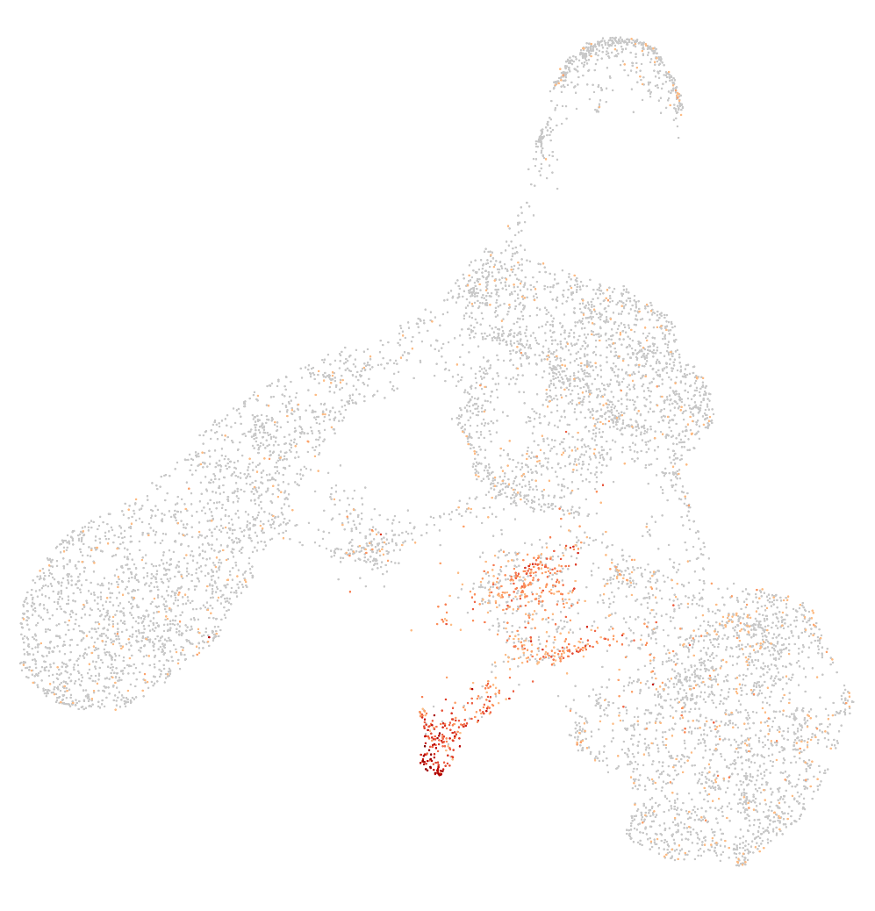
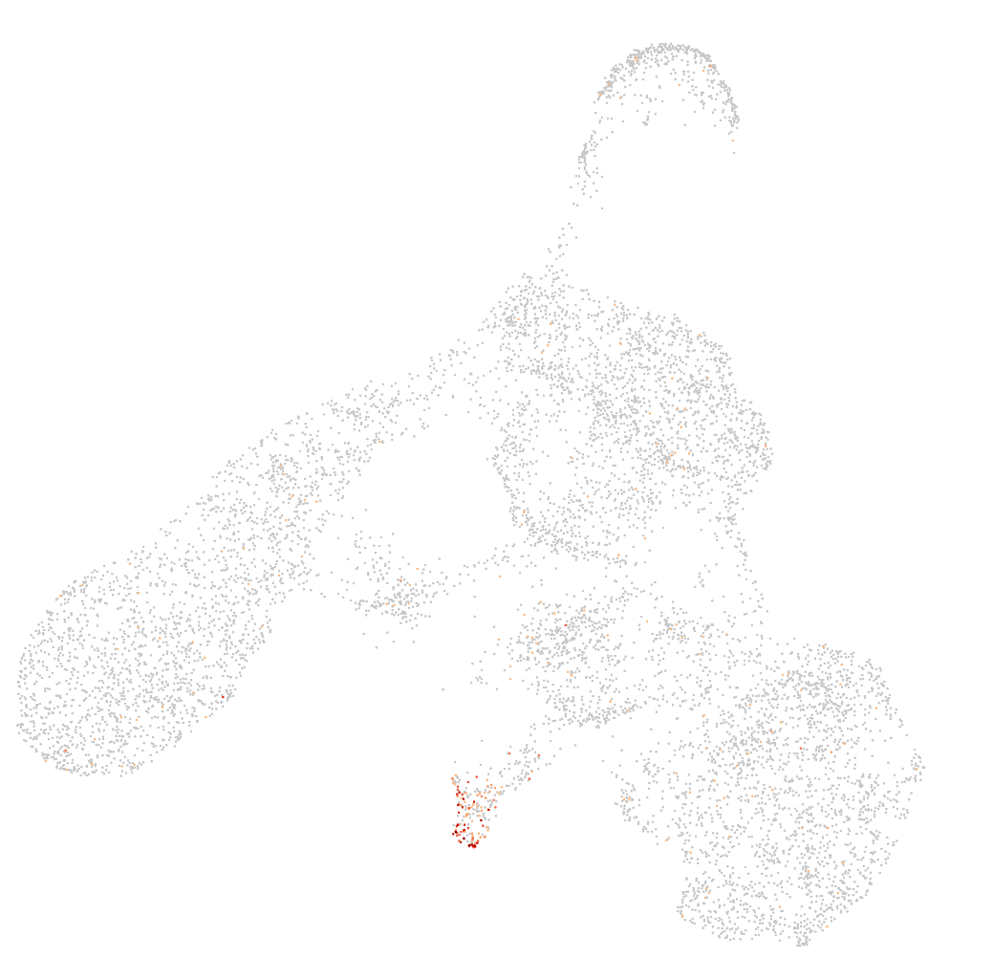
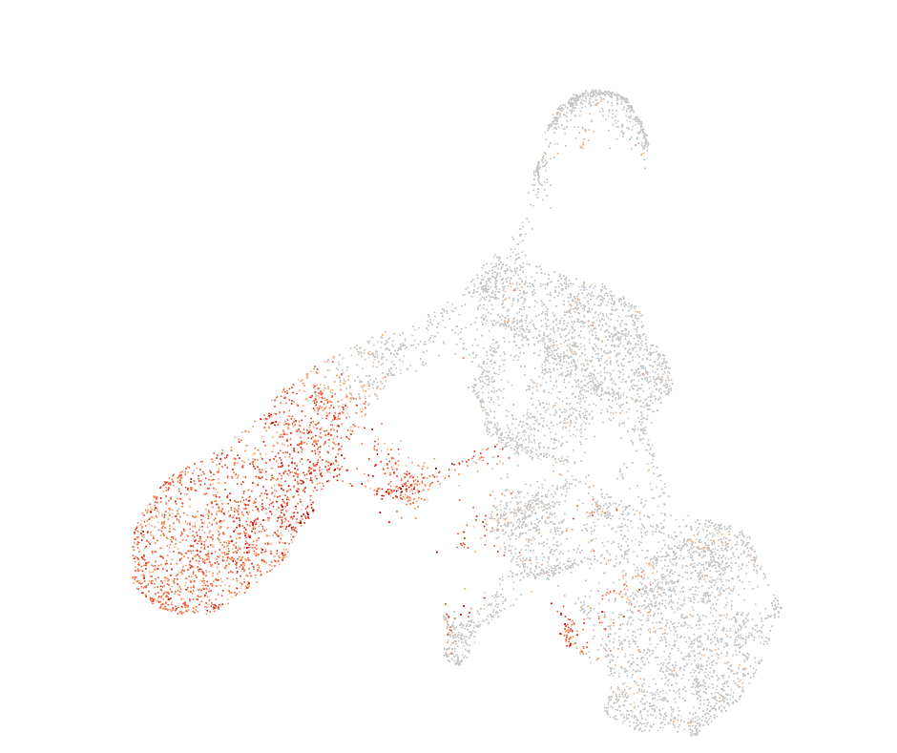
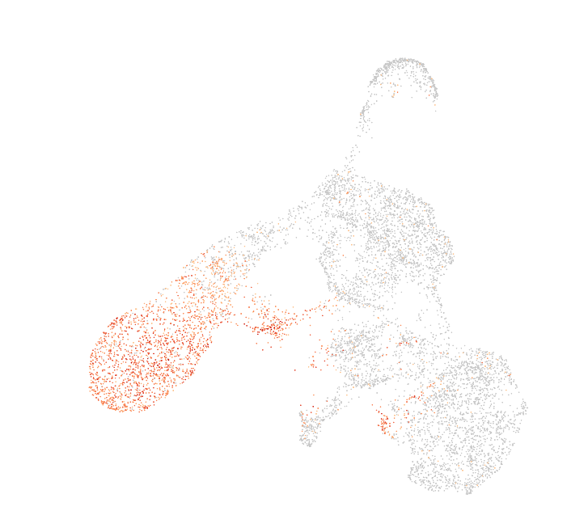
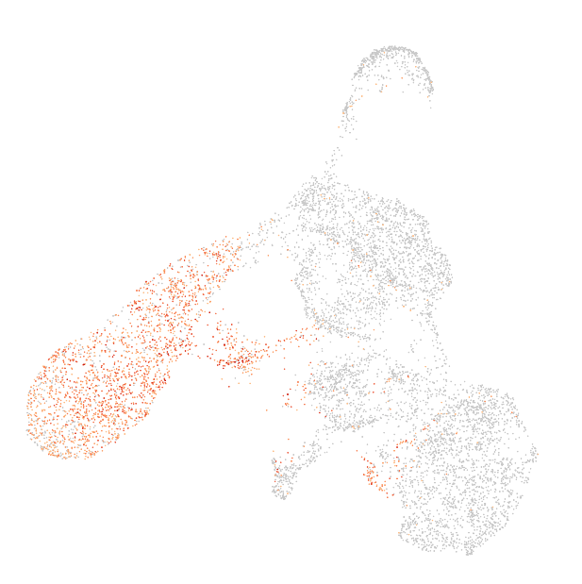
Day22: Initial analysis mucles cells markers
Cluster assignments
CKM
TNNT1
MYT1L
GRIA2
SRRM4
top 3 differently expressed genes
in green cluster
-> associated with neuronal tissues
Notes:
First row more muscle cell markers
Second row top 3 differently expressed gene in green cluster -> associated with neuronal tissues

Slide 13
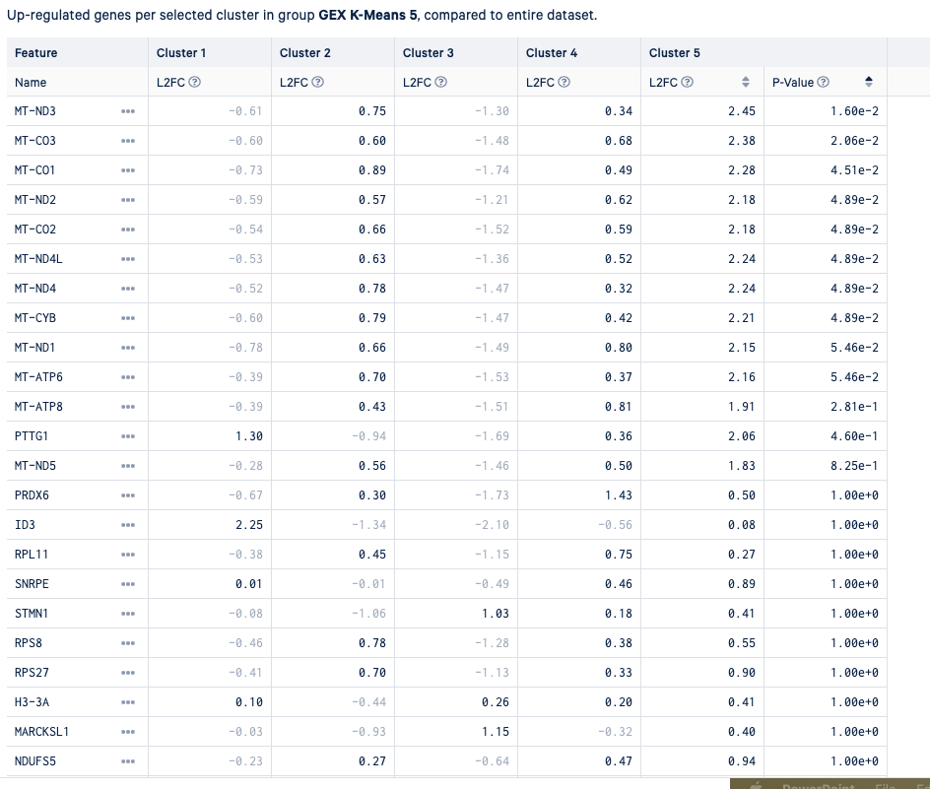
Mitochondrial cell almost all differently expressed genes ->
dead cells?

Slide 14
Day 22
Dead cells
Myogenetic progenitors
Neuronal tissues
Myoblast
Skeletal mesenchymal
Myocytes + myotube

Slide 15
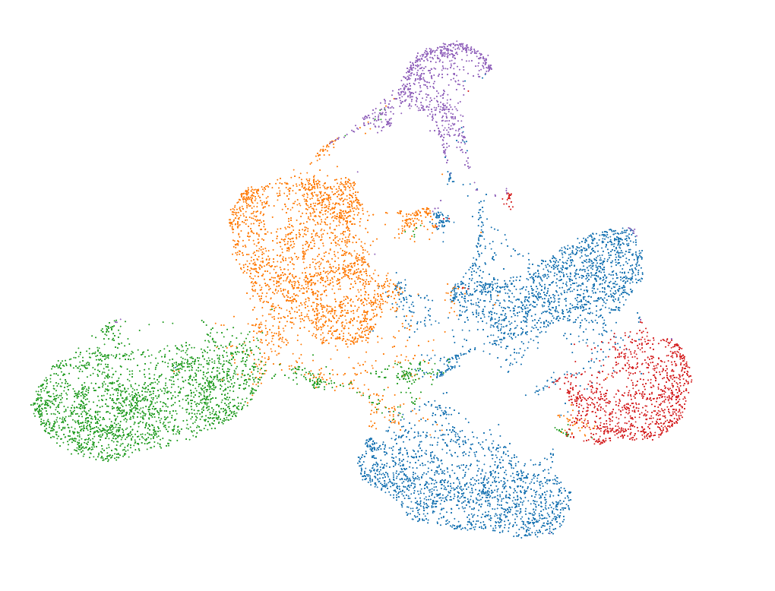
Day 22
RNA UMAP + K-means clustering (k=5)
Notes:
From the 10X pipeline

Slide 16
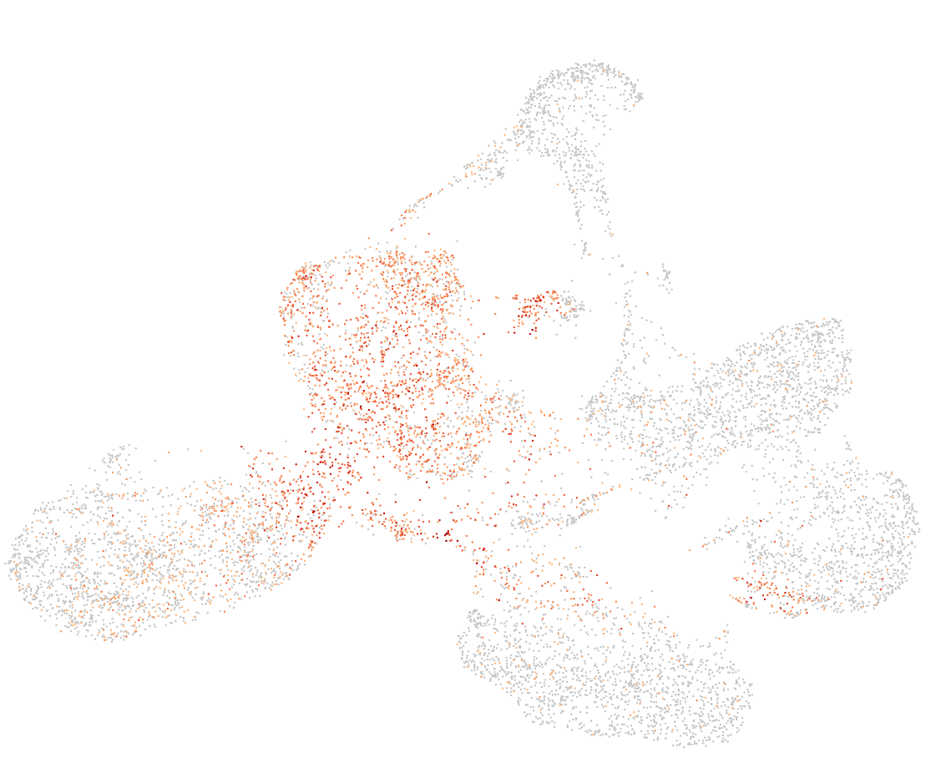
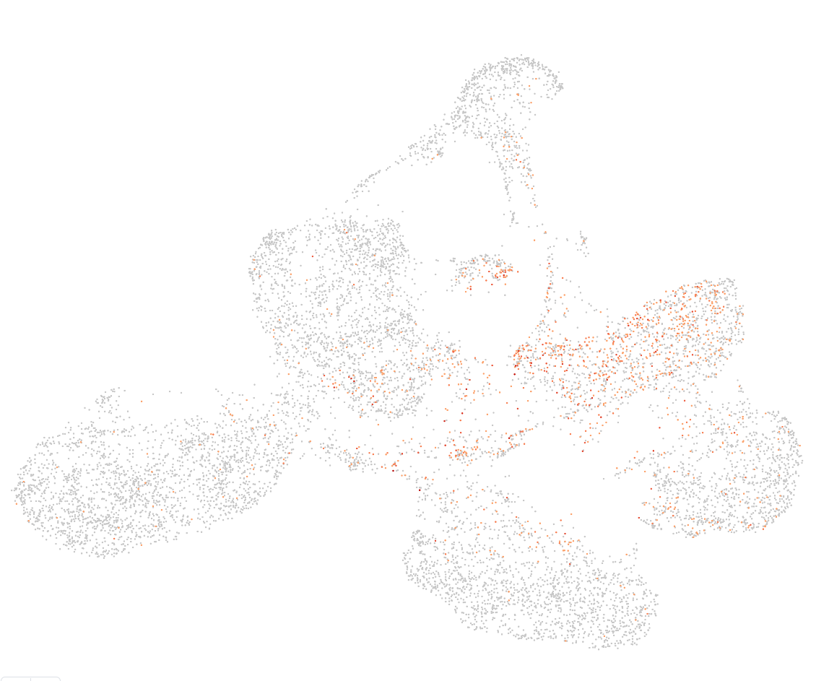
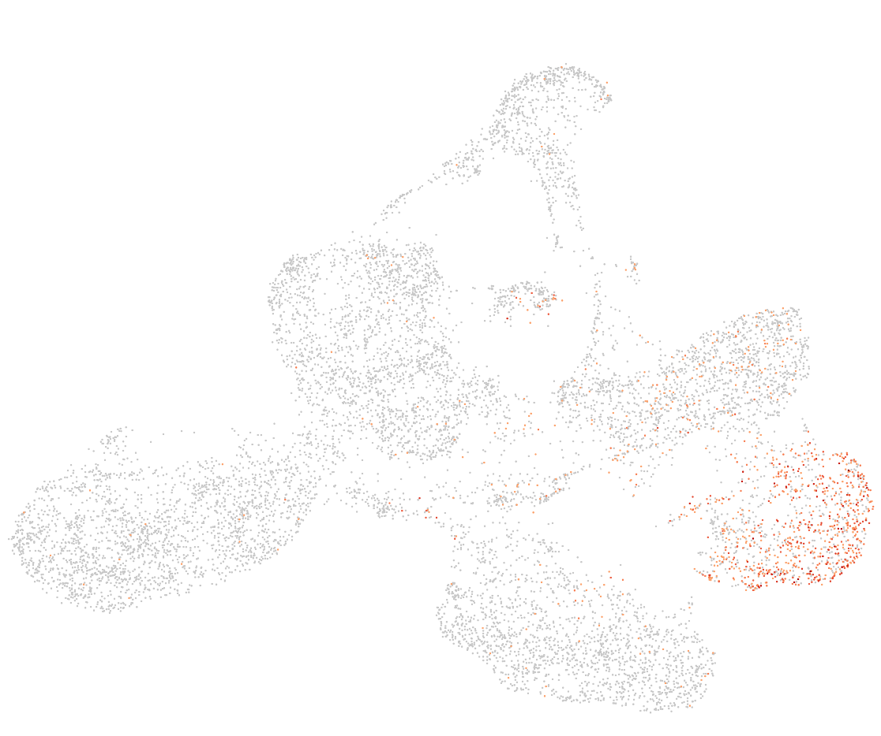
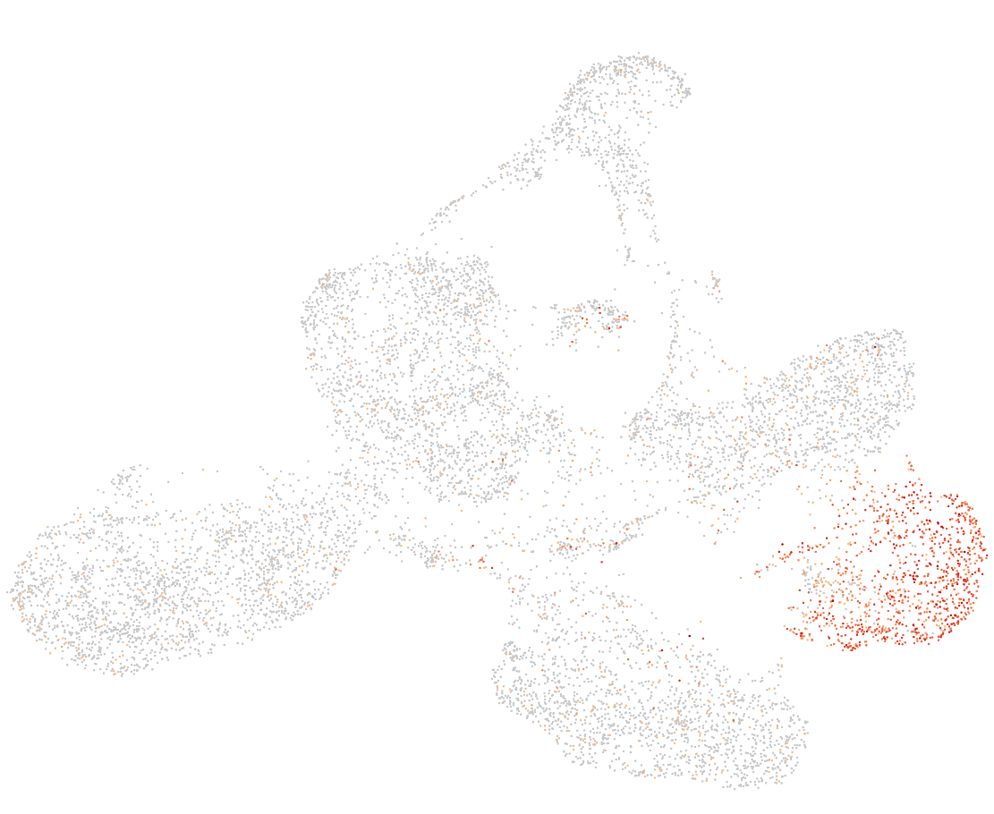
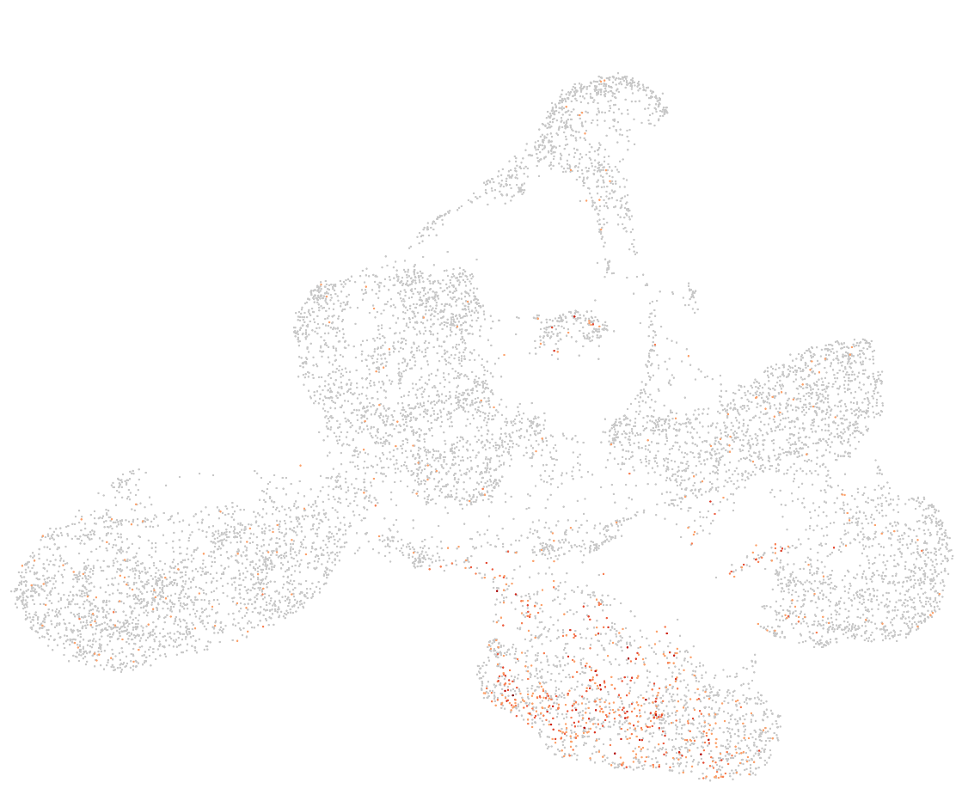
Day12: Initial analysis mucles cells markers
Cluster assignments
PAX3
PAX7
MYOD1
MYOG
OGN
PDGFRA
HEY1
Notes:
No expression of muscle cell markers (PAX7, MYOD1,…), but a bit of the OGN PDGFRA -> messenchymal

Slide 17
Day22: Initial analysis mucles cells markers
Cluster assignments
CKM
TNNT1
MYT1L
GRIA2
SRRM4
top 3 differently expressed genes
in green cluster
-> associated with neuronal tissues
Notes:
First row more muscle cell markers
Second row top 3 differently expressed gene in green cluster -> associated with neuronal tissues

Slide 18
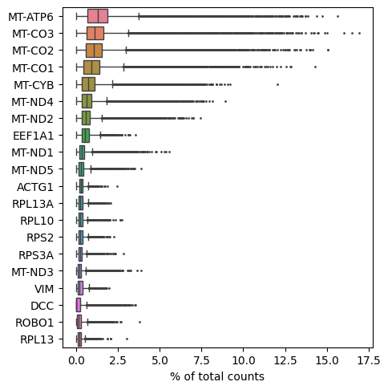
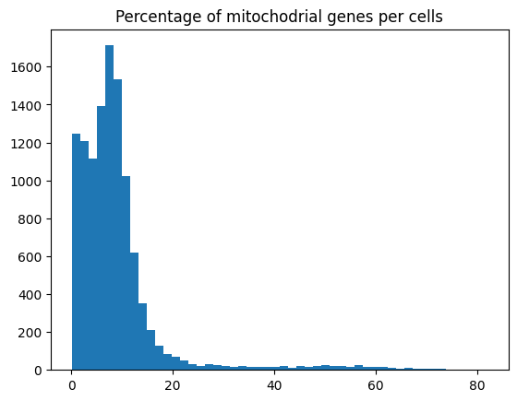
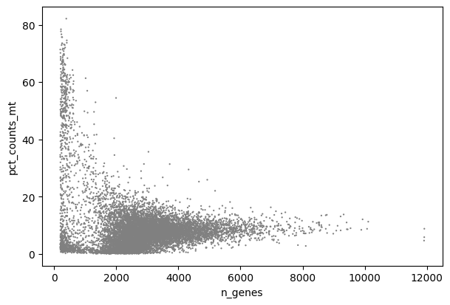
Day 20: exploration gene expression using scanpy
Very high mitochondrial counts in a lot of cells
dead/stressed cells
High energy cells tend to have higher percentage of mitochondrial genes
Remove the extreme values (>20%) , but keep rest as they may be biologically relevant

Slide 19
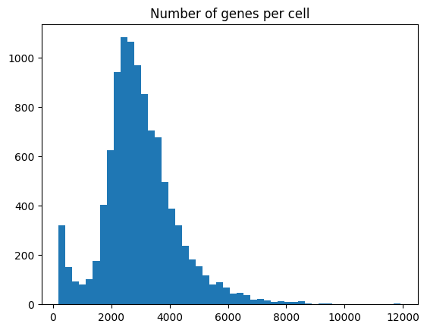
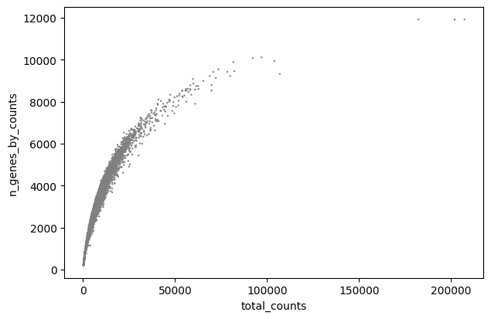
Day 20: exploration gene expression using scanpy
Filtering cells:
We remove the cells with extreme percentage of mitochondrial values (>20%)
Remove the cells with extreme total counts (> 100 000)
For now we keep the cells with low and high number of features
Filtering is an iterative process, demanding on downstream analysis we can descide to filter more cells

Slide 20
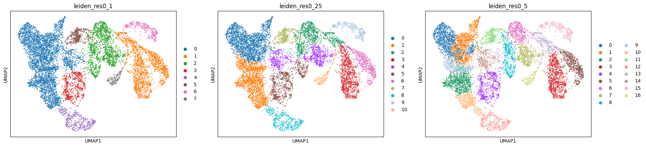
Day 20: exploration gene expression using scanpy
Normalization -> select highly variable genes -> scaling -> PCA -> Leiden clustering
For Leiden we need the most appropriate resolution
May be better to start with more clusters and fuse them iteratively -> resolution 0.5

Slide 21


Day 20: exploration gene expression using scanpy
Almost all low counts seems to be in the same cluster
Whereas the high counts cells are more spread out
Might be good idea to remove the high counts, but not low counts yet still need to determine what they are
Clustering looked nicer before let’s start from there for the cell type annotations

Slide 22

Day 20: exploration gene expression using scanpy
High mitochondrial percentage (>10%)
Hypothesis: Differentiaciating muscle cells are high energy consumptions
Induced differentation stressed particularly the cells?

Slide 23

Day 20: exploration gene expression using scanpy
Almost all low counts seems to be in the same cluster
Whereas the high counts cells are more spread out
Might be good idea to remove the high counts, but not low counts yet still need to determine what they are
Clustering looked nicer before let’s start from there for the cell type annotations

Slide 24

Day 20: exploration gene expression using scanpy
Low feature count
Low mitochondrial %
Only gene differently expressed when compared to rest ribosomal gene
What are they????

Slide 25


Day 20: exploration gene expression using scanpy
Cluster 0
Cluster 1
General development, differentiation, neurogenesis
-> Same for clusters 2, 9

Slide 26

Day 20: exploration gene expression using scanpy
Cluster 4
Similar to cluster 0-2 + 9 , but now cell cycle in top GO enriched terms

Slide 27

Day 20: exploration gene expression using scanpy
Cluster 10
Muscle cell development

Slide 28

Day 20: exploration gene expression using scanpy
Cluster 12
Actin-myosin filament + muscle contraction + myofibril assembly + muscle organization

Slide 29
Day 20: exploration gene expression using scanpy
Cluster 6-8
General development process+ neuronal development

Slide 30

Day 20: exploration gene expression using scanpy
Cluster 3,5,15
Neuronal development, axon elongation

Slide 31


Day 20: exploration gene expression using scanpy
Remove the identified neuronal cell types
Forgot some (differently expressed genes for neuron )

Slide 32



Day 20: exploration gene expression using scanpy
Label cell types only for muscle cells

Slide 33


Day 20: exploration gene expression using scanpy
Expected GO terms enrichment
Notes:
https://www.sciencedirect.com/science/article/pii/S1934590920301569

Slide 34








Evolution TFs cut&tag : MYOD1
D8
D12
D20
D22
gene
motif
Notes:
https://www.sciencedirect.com/science/article/pii/S1934590920301569

Slide 35








Evolution TFs cut&tag : MYOG
D8
D12
D20
D22
gene
motif
Notes:
https://www.sciencedirect.com/science/article/pii/S1934590920301569

Slide 36




Evolution TFs cut&tag : HEYL
D8
D12
D20
D22
gene
Notes:
https://www.sciencedirect.com/science/article/pii/S1934590920301569

Slide 37








Evolution TFs cut&tag : HES1
D8
D12
D20
D22
gene
motif
Notes:
https://www.sciencedirect.com/science/article/pii/S1934590920301569

Slide 38








Evolution TFs cut&tag : PAX3
D8
D12
D20
D22
gene
motif
Notes:
https://www.sciencedirect.com/science/article/pii/S1934590920301569

Slide 39








Evolution TFs cut&tag : PAX7
D8
D12
D20
D22
gene
motif
Notes:
https://www.sciencedirect.com/science/article/pii/S1934590920301569

Slide 40


Exploration accessibly across timepoints
Exploration accessibly across timepoints (average number peaks 215 933)
Exploration accessibly across replicates
Very different peaks across replicates
Very few peaks overlap across the timepoints

Slide 41

Exploration accessibly across timepoints
Looks the same in all time points.
-> More pluripotent cells tend to be more accessible
Not that many accessible regions for each cells -> almost all have less than 1000 peaks accessible
10x pipeline seems to have remove a lot of them.

Slide 42
Next
ATAC seq exploration
------------------
Remove cells identified as neuronal tissues?
Use all dataset at same time to do clustering?

